Slide 1
Direct Marketing campaign of a European Banking institution
Avinash Reddy K

Slide 2
Problem & Approach for the Analysis
We need to improve the return for the Marketing Campaign for the Banking institution
We need to generate the target list of attributes that are likely to be important factors for customers to make, the Term deposit in the bank
We need to executive the campaign, in such a way that, there will be +ve return of investment for the campaign
We need to use ML techniques to estimate the target customers & their preferences for the campaign

Slide 3
Exploration Analysis of the data:
The given data consists of 21 different variables (consists of both dependent ,independent var) They fall into 4 major groups
Inputs : Demographic information (age,job,education,loans)
Last contact of current campaign(contact,day,month,duration)
Other Attributes Previous campaign details(poutcome,pdays,previous)
Social and environment attributes (emp.var.rate, cons.conf.idx,nr.employed)
Outputs: Response (y/n)

Slide 4
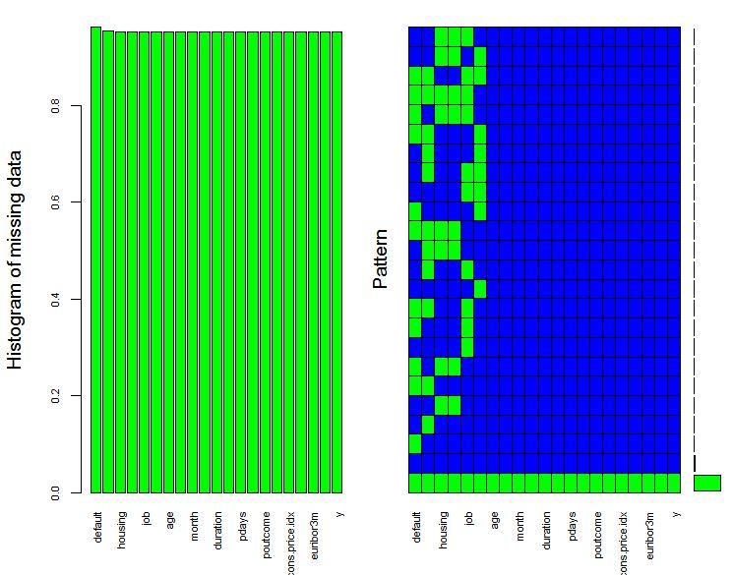
EDA – Missing data analysis
Imbalanced Dataset – 41188 rows
Target Variable(y):
yes -11.26%
no- 88.74%
Attributes (Missing Data %):
Default – 20.87%
Education – 4.20%
Housing – 2.04%
Loan – 2.04%
Job – 0.80%
Marital – 0.19%

Slide 5
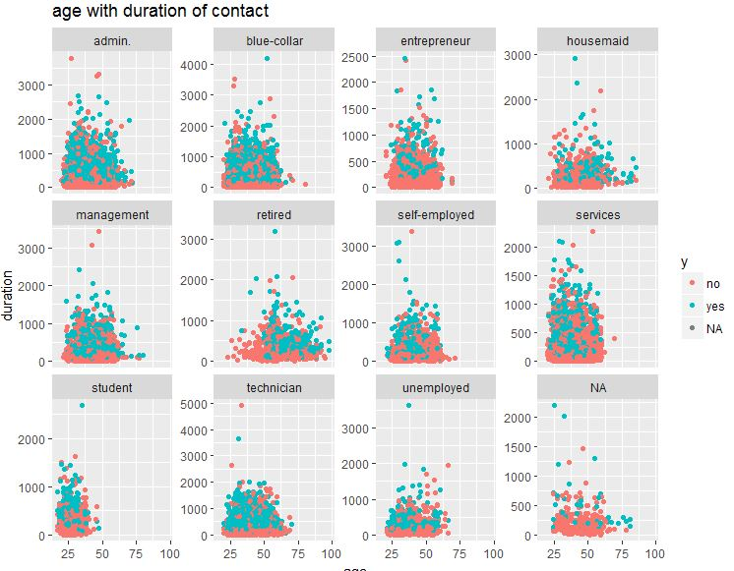
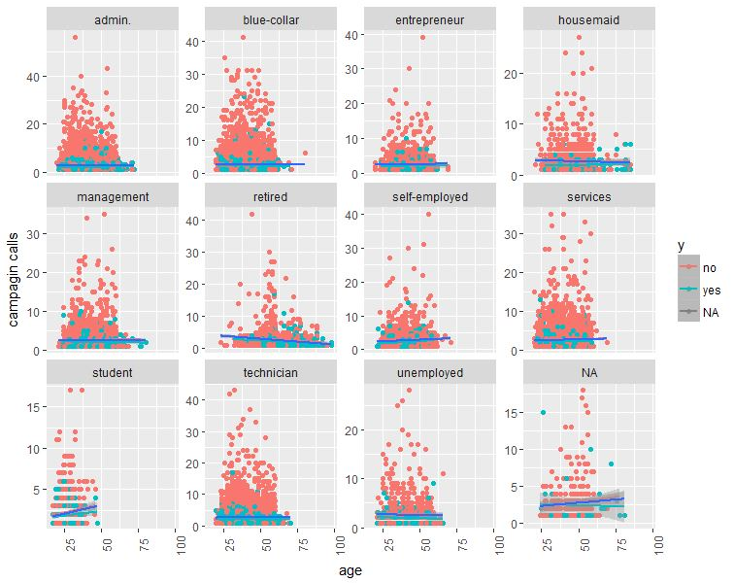
Variations wrt Age, Job, Duration of call Variations wrt Age ,job, campagain call

Slide 6
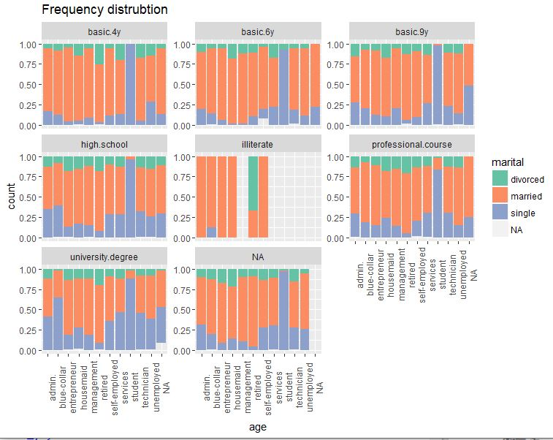
Education wrt Martial status & Job

Slide 7
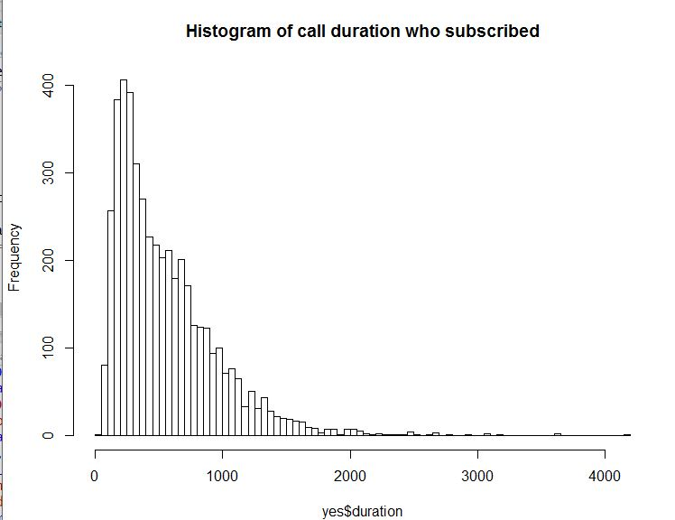
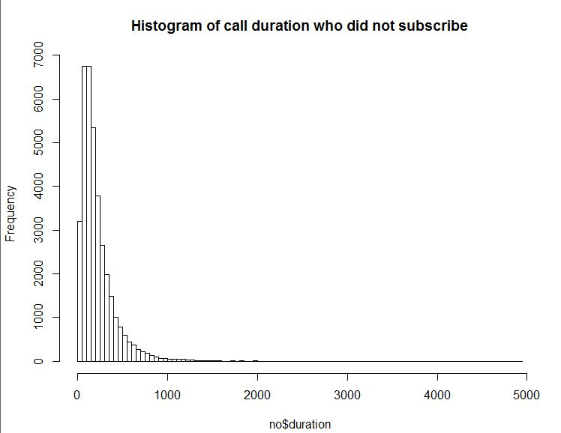
Implications based on Important Variables
Contacts with Cellular options had Highest call duration

Slide 8
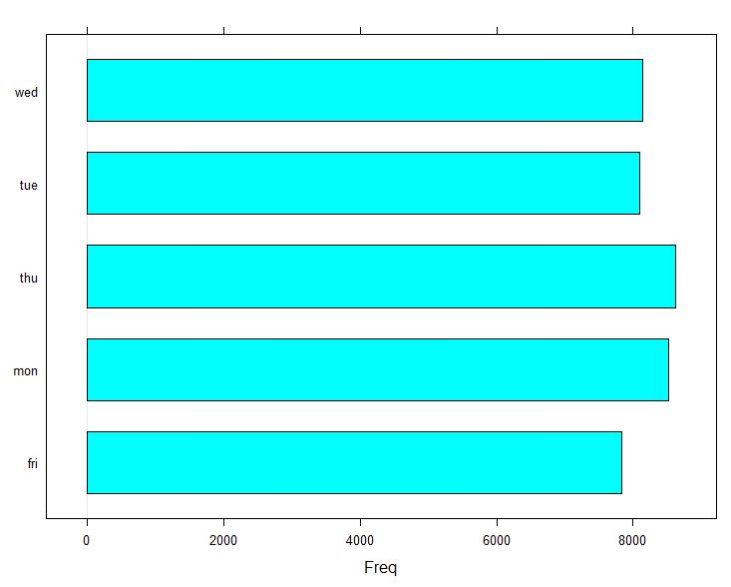
Duration time of call in week and call duration of people who subscribed

Slide 9
Feature Selection
Missing Values
Replaced all missing values with mean/mode of continuous/categorical variables.
No significant improvement in accuracy
Feature Selection
All features were retained after selectively discarding some variables while training the dataset.
Accuracy reduced when contact, month and day_of_week were removed.
Variable Transformation
Logarithmic variable transformation was done on age as it was right-skewed – No significant improvement was noticed.
Binning Age, Campaign, Pdays.

Slide 10
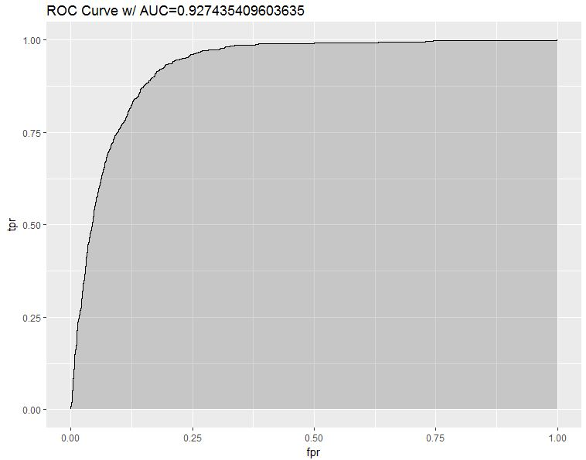
Logistic Regression
Output – Binary(yes/no)
More Categorical variables
Assuming Cost of FP & FN
Set threshold to minimize cost

Slide 11
ML Algorithm Outcome
Model Accuracy False Negative
Logistic Regression 90.02% 538
Random Forest 89.25% 109

Slide 12
Interpretation:
The conversion rate will be high for clients with Job – Retired , Students
The conversion rate is high for clients with education - university.degree
The conversion rate is high for clients with contact - cellular phone
The conversion rate is high for clients with contact last month of the year – mar,sep,oct,dec
(obtained by performing pearson’s chi-squared test and tableau)

Slide 13
Recommendations:
Contact & Month are determinant to define a communication strategy and assign resources more efficiently
Job & Education could be use as are some important factors we need to consider before starting the campaign
Approaching the right set of customers can help us to achieve our target reach
By, following some of the above recommendations we can reduce the miscalculations

